Slide 1


Slide 2
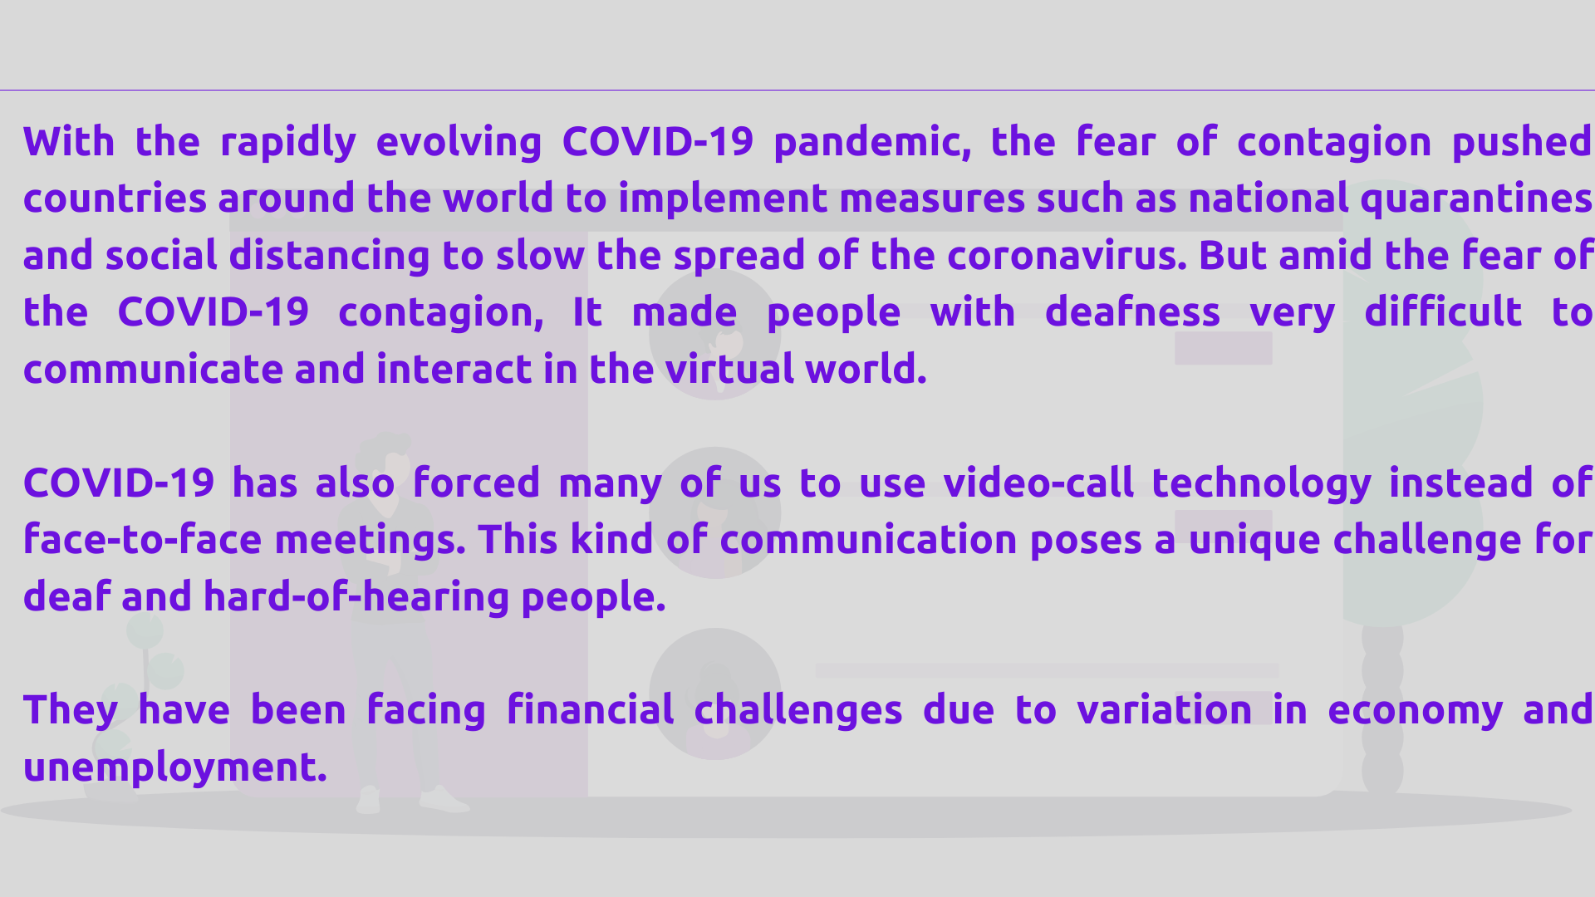

Slide 3
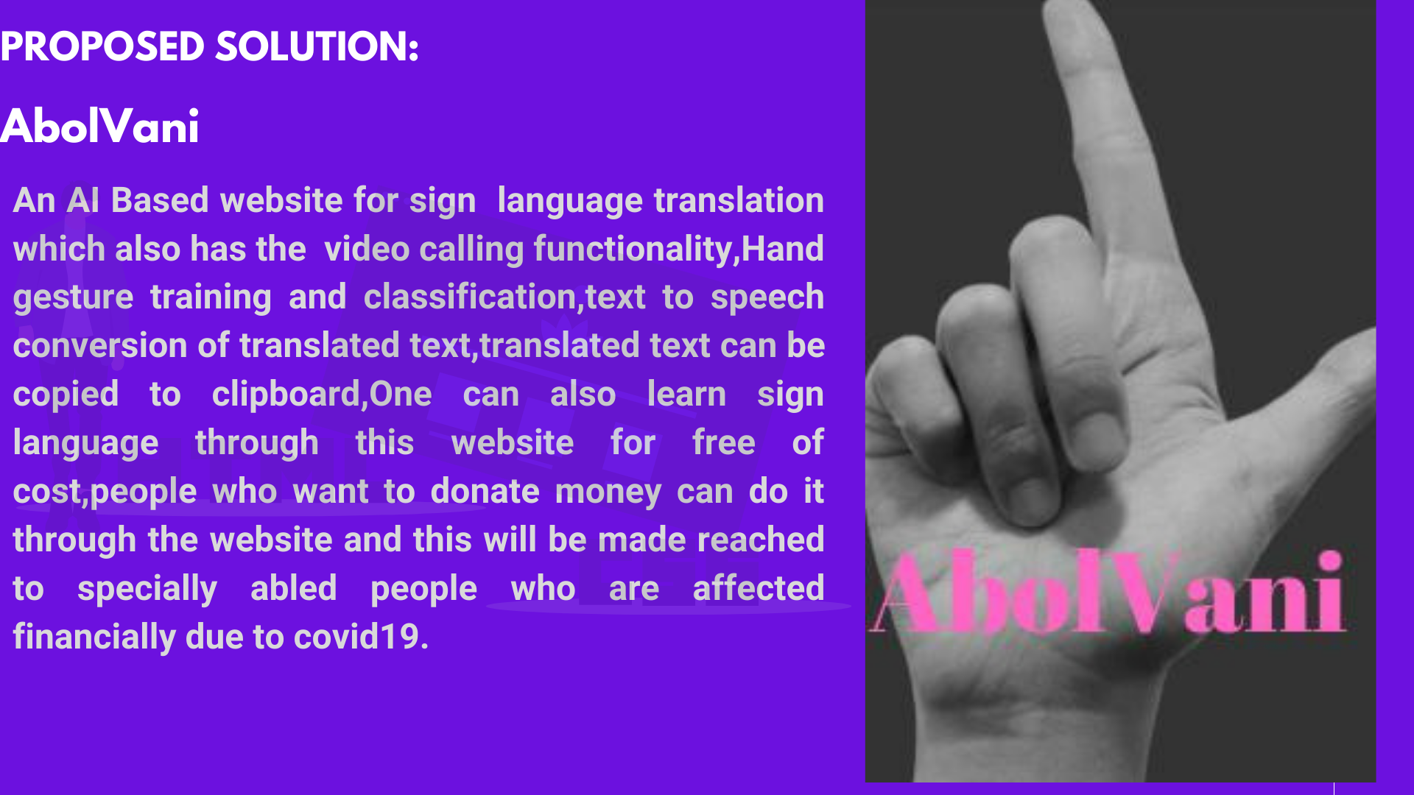

Slide 4
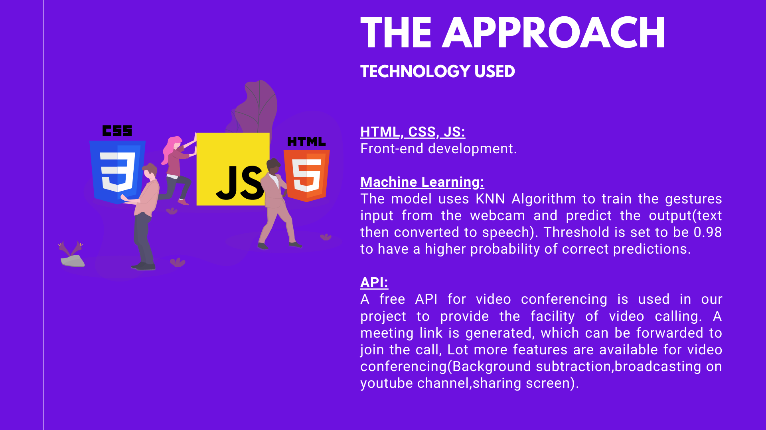

Slide 5


Slide 6
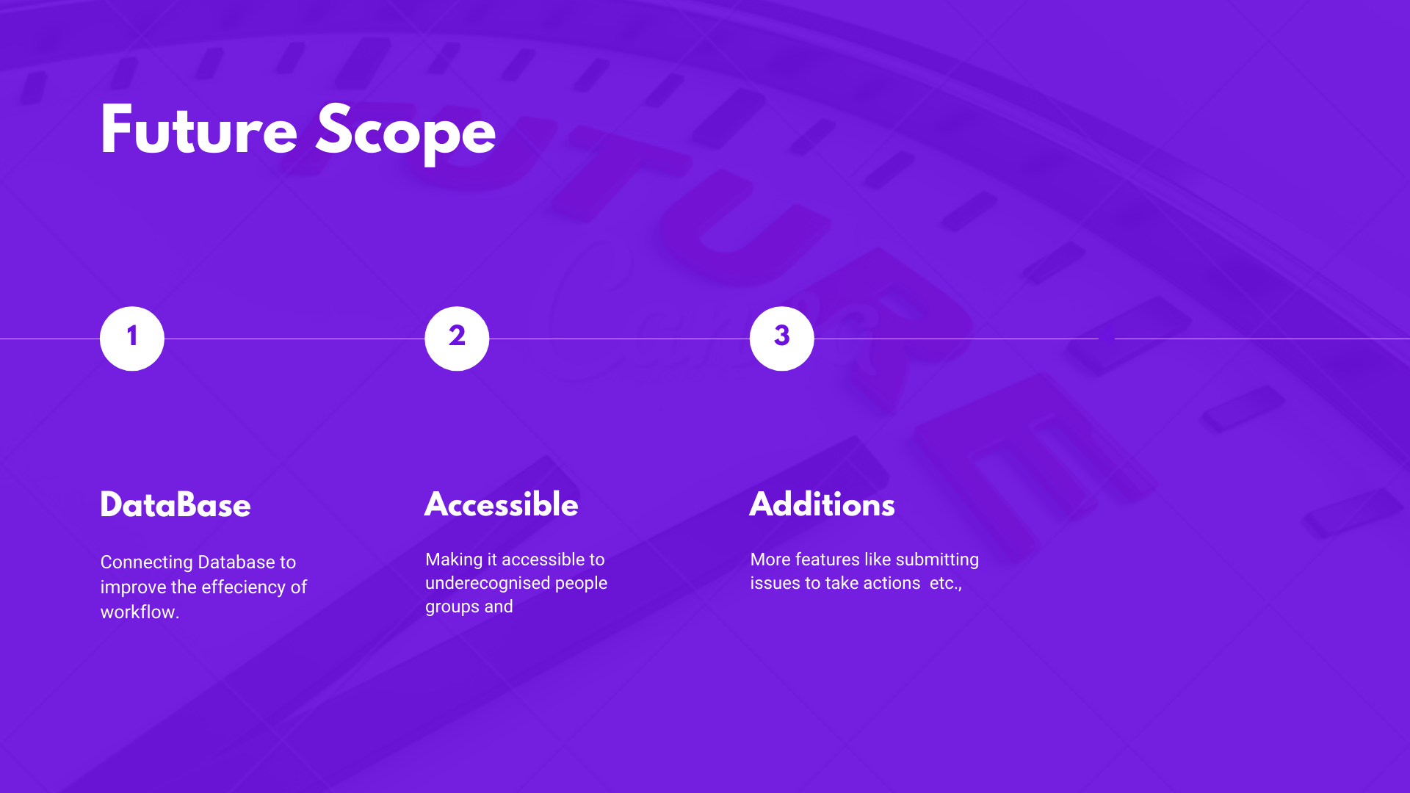

Slide 7
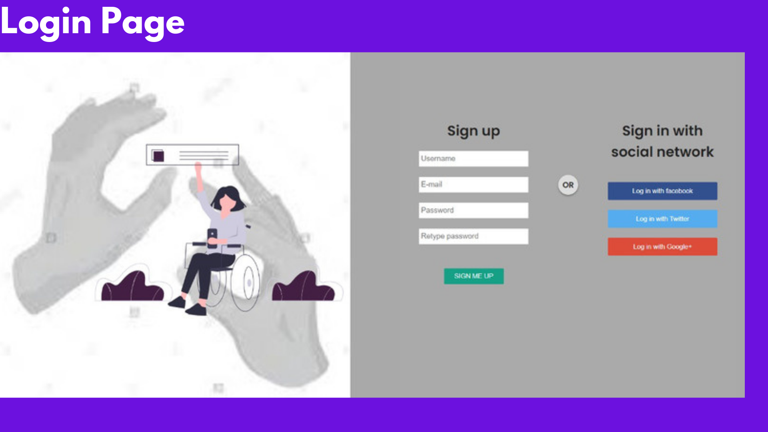

Slide 8
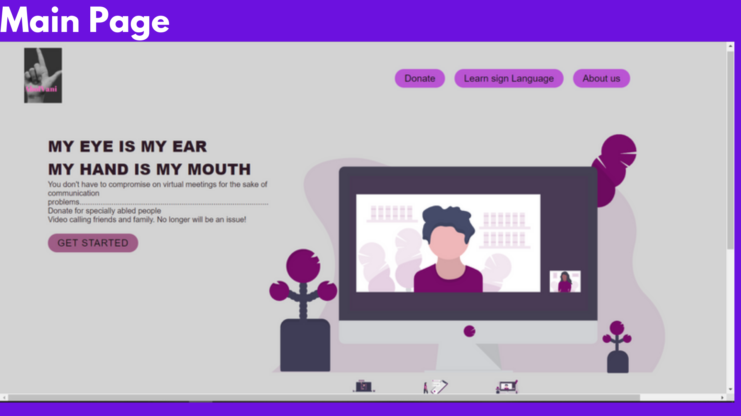

Slide 9
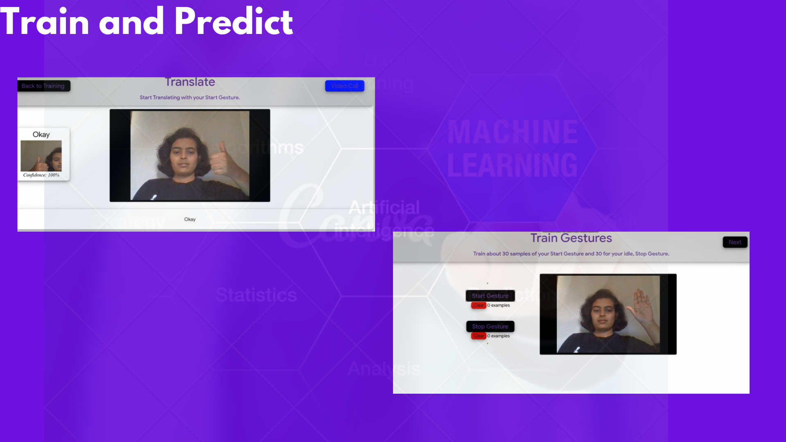

Slide 10

https://drive.google.com/file/d/1EpdtKZduefm_b1-mkGcW12mlmHJOc8R9/view?usp=sharing

Slide 11


Slide 12


